Slide 1

Design, simulation and construction of a bipedal platform for human-like locomotion studies
Authors
Jorge Rodriguez Marin Ignacio Torroba Balmori
Supervisors
Jørgen Christian Larsen Poramate Manoonpong
Notes:
[J]

Slide 2
Headline
Introduction
State of the art
Analysis
Mathematical model
Mechatronic design
Simulation
Results
1/30

Slide 3
Structure
Introduction
State of the art
Analysis
Mathematical model
Mechatronic design
Simulation
Results
1/30
Notes:
[J]

Slide 4
Individual workload
Jorge
Ignacio
Analysis
State of the art
Analysis
Mathematical model
Design: electronics and locokit interface
Design: mechanics, ROS integration, example controllers
Simulation
Implementation
Introduction
State of the art
Analysis
Mathematical model
Mechatronic design
Simulation
Results
1/30
Notes:
[J]

Slide 5
Structure
Introduction
State of the art
Analysis
Mathematical model
Mechatronic design
Simulation
Results
1/30

Slide 6
Motivation
On-going line of research at MMMI
Existing models are complex and expensive
Do not offer all the needed capabilities
Introduction
State of the art
Analysis
Mathematical model
Mechatronic design
Simulation
Results
1/30
Notes:
[J]

Slide 7
Goals
Working prototype
Simulation environment
Test bench
Mathematical framework
Introduction
State of the art
Analysis
Mathematical model
Mechatronic design
Simulation
Results
1/30
Notes:
[J]

Slide 8
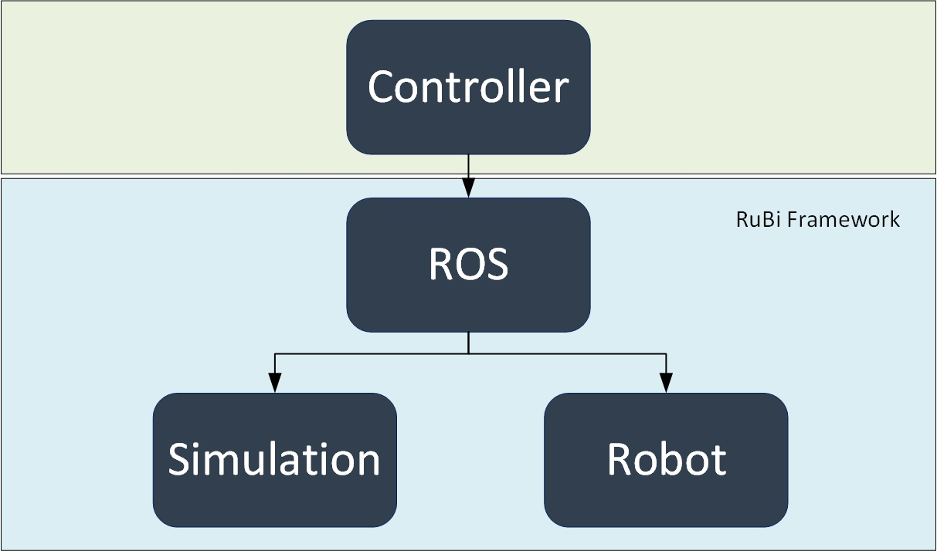
Overall idea
Introduction
State of the art
Analysis
Mathematical model
Mechatronic design
Simulation
Results
1/30
Notes:
[J]

Slide 9
Why biped locomotion
Multiple legs
Bipeds
Wheeled robot
Introduction
State of the art
Analysis
Mathematical model
Mechatronic design
Simulation
Results
1/30
Notes:
[N]

Slide 10
Biomechanics and control
Milestones in evolution
System dynamics in control theory
Hardware capabilities
Embodied AI
Introduction
State of the art
Analysis
Mathematical model
Mechatronic design
Simulation
Results
1/30
Notes:
[N]

Slide 11
Cutting-edge
ATLAS
HRP 4C
RuBi
Introduction
State of the art
Analysis
Mathematical model
Mechatronic design
Simulation
Results
1/30
Notes:
[N]

Slide 12
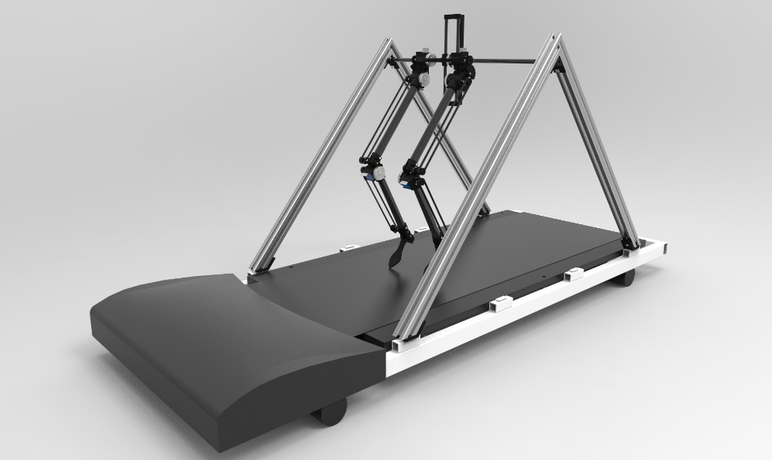

Conceptual design
Introduction
State of the art
Analysis
Mathematical model
Mechatronic design
Simulation
Results
1/30
Notes:
[N]

Slide 13
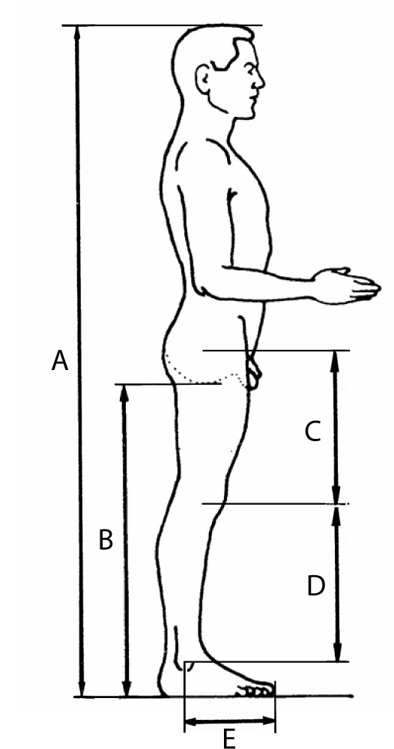
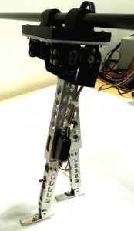
Geometric and inertial dimensions
Introduction
State of the art
Analysis
Mathematical model
Mechatronic design
Simulation
Results
Minimize inertias
Reduce overall mass
Sagittal symmetry
CoM placement
1/30
Notes:
[N]

Slide 14
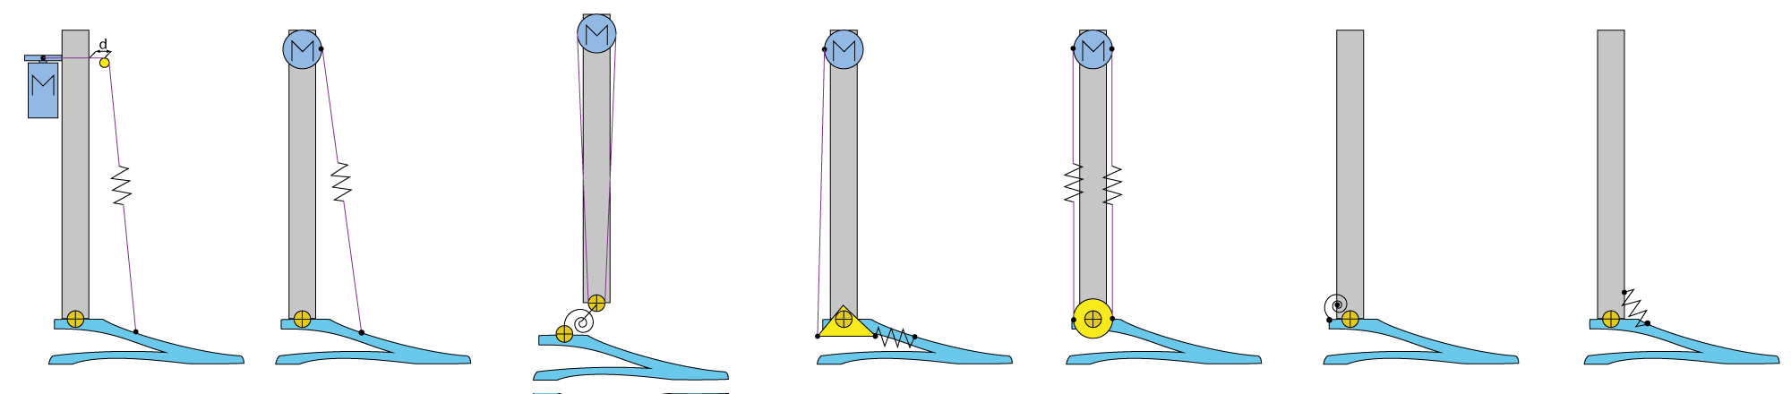
Joint design
Introduction
State of the art
Analysis
Mathematical model
Mechatronic design
Simulation
Results
SEA
PEA
1/30
Notes:
[N]

Slide 15
Equations of motion
Need of actuators sizing
Application definition
Kinematic and dynamic model
Hopping controller
Introduction
State of the art
Analysis
Mathematical model
Mechatronic design
Simulation
Results
1/30
Notes:
[N]

Slide 16
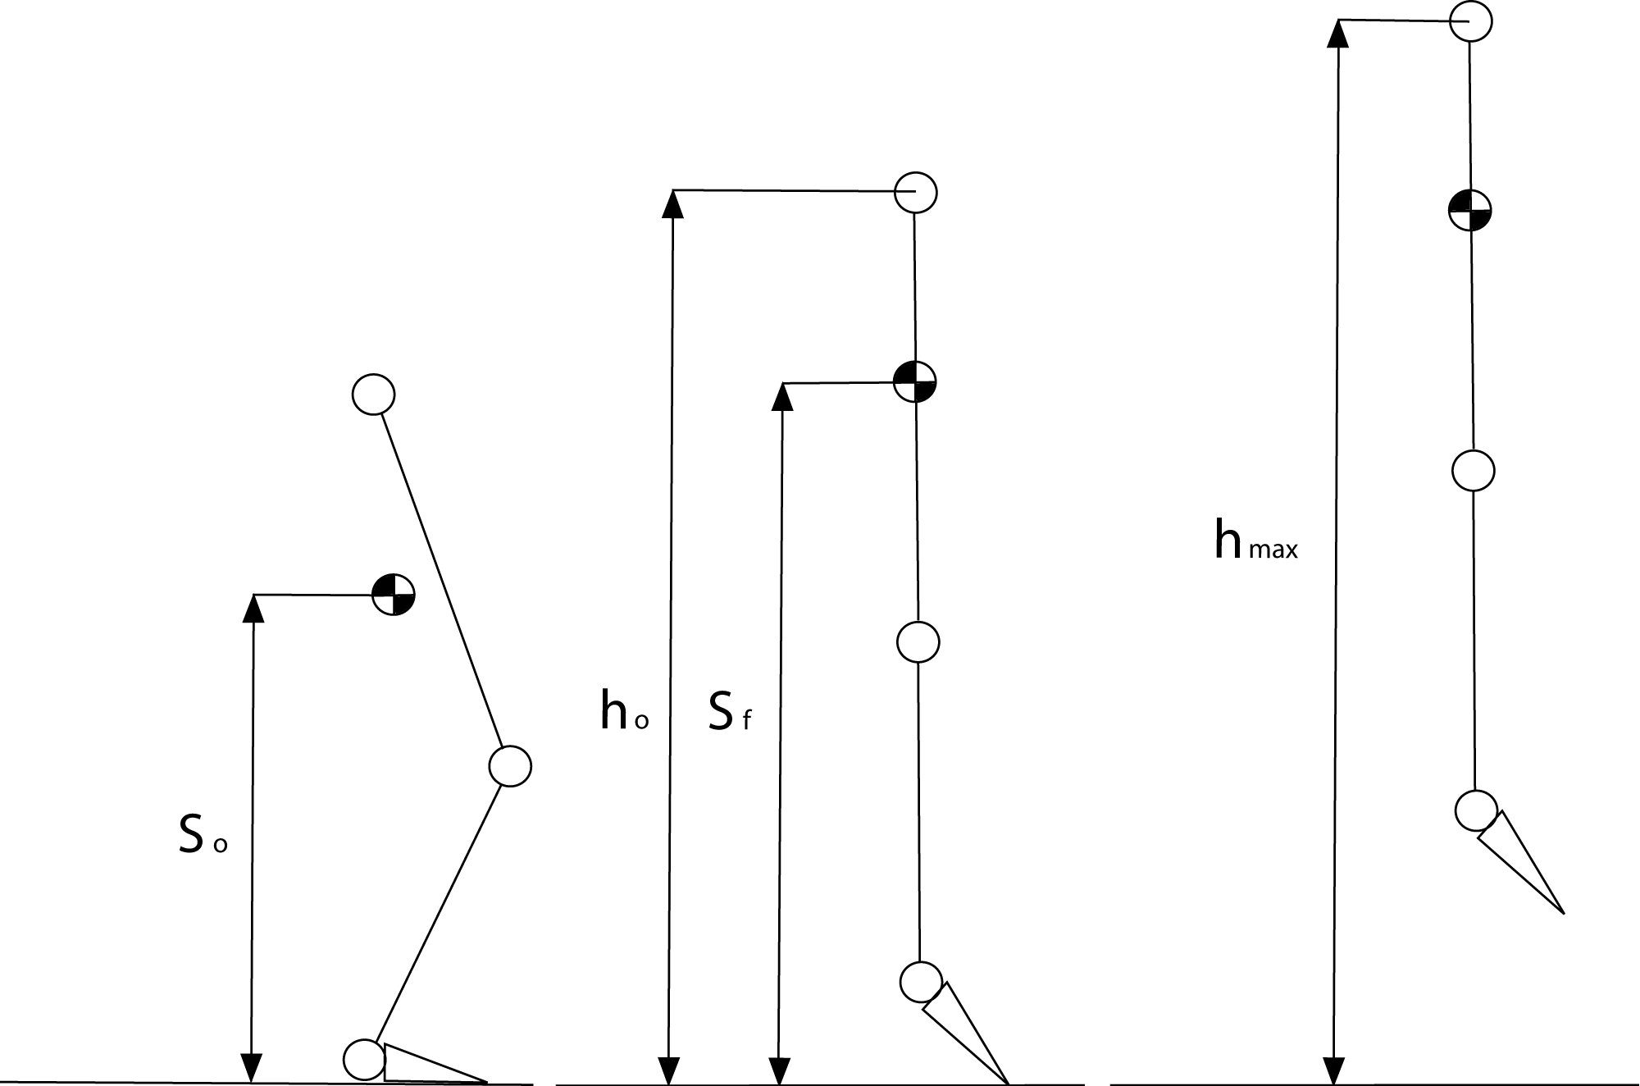
Vertical jump case
Introduction
State of the art
Analysis
Mathematical model
Mechatronic design
Simulation
Results
Impulse phase
Take-off phase
Aerial phase
1/30
Notes:
[N]

Slide 17
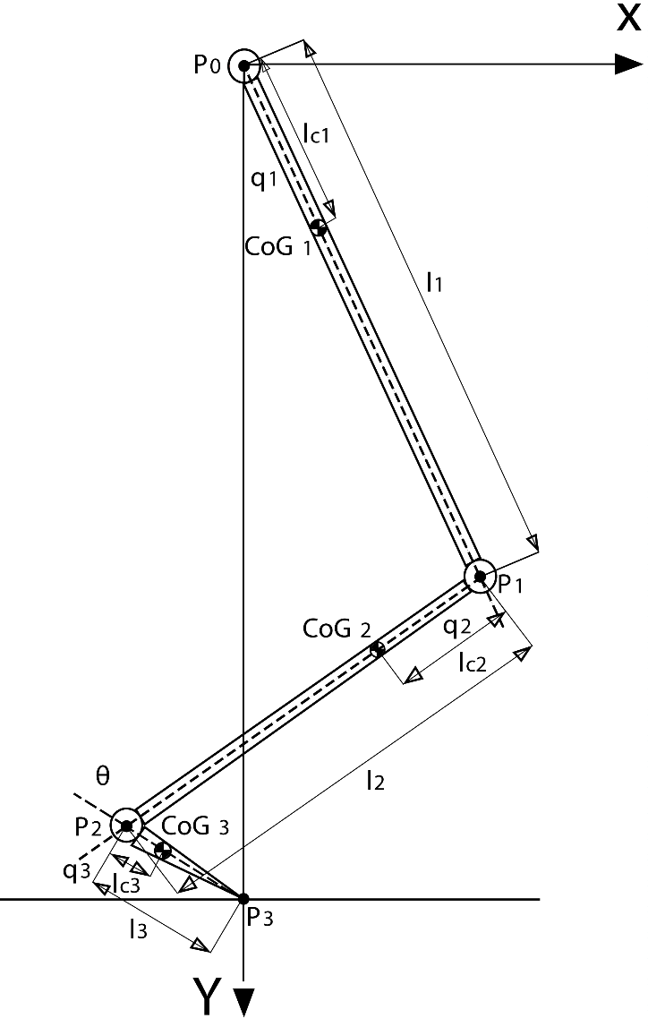
Kinematic and dynamic model
Introduction
State of the art
Analysis
Mathematical model
Mechatronic design
Simulation
Results
$$B\left(q\right)\ddot{q}+C\left(q,\dot{q}\right)\dot{q}+g\left(q\right)=τ$$
Inertia matrix
Coriolis and centrifugal terms
Gravity
1/30
Notes:
[N]

Slide 18
Actuation
LocoKit motors
Transmission
Rotational springs
Hip: gears 2:1
Knee and ankle: belts and pulleys 1:1
SEA, PEA, SEA+PEA
Reconfigurable springs
Introduction
State of the art
Analysis
Mathematical model
Mechatronic design
Simulation
Results
1/30
Notes:
[J]

Slide 19
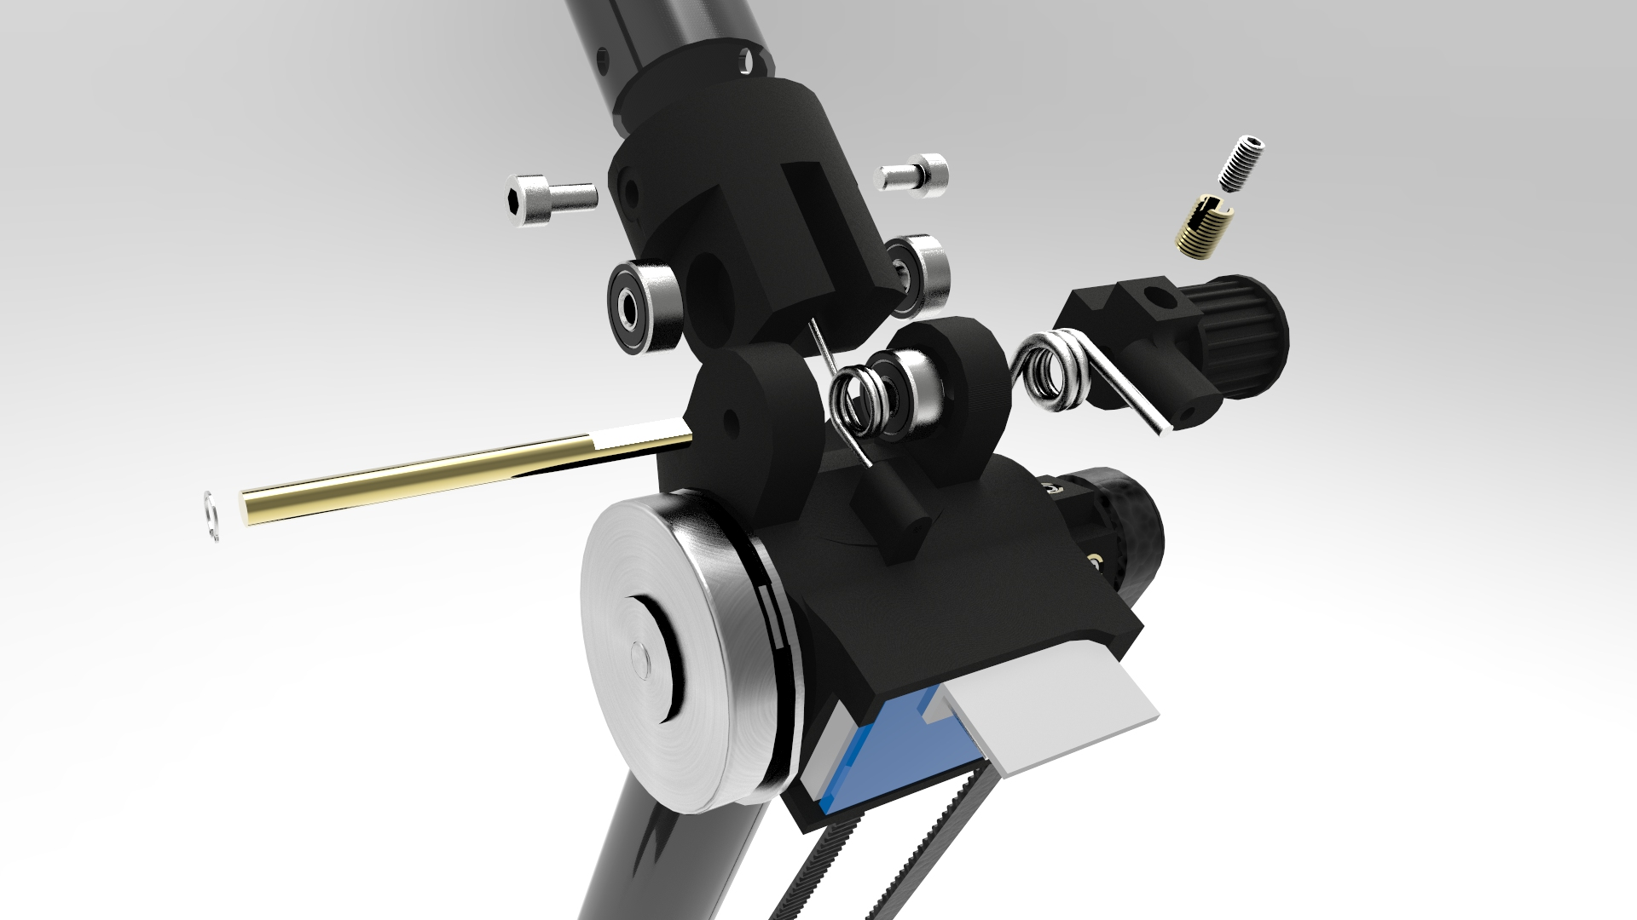
Actuation
Introduction
State of the art
Analysis
Mathematical model
Mechatronic design
Simulation
Results
1/30
Notes:
[J]

Slide 20
Frame
Structural analysis
Mechanical joint limits
CAD design and FEM
Introduction
State of the art
Analysis
Mathematical model
Mechatronic design
Simulation
Results
1/30
Notes:
[J]

Slide 21
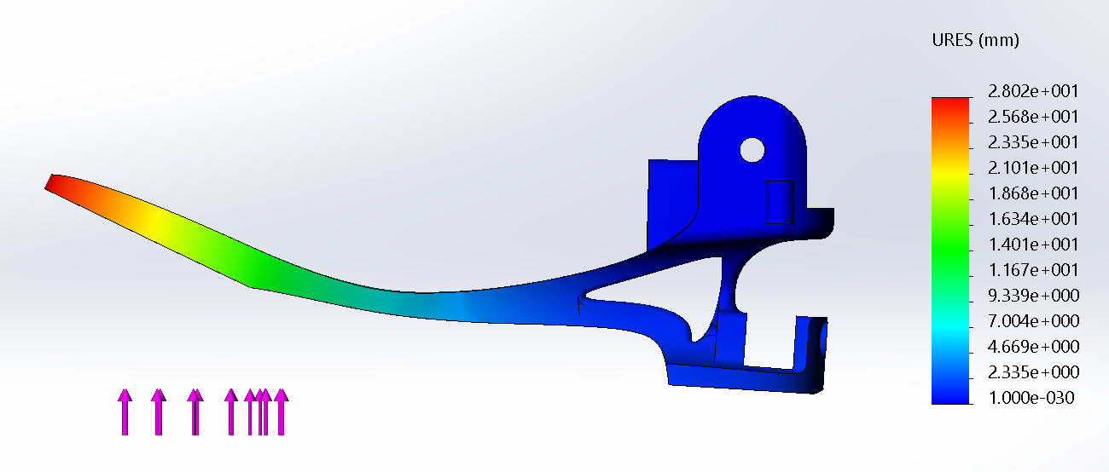
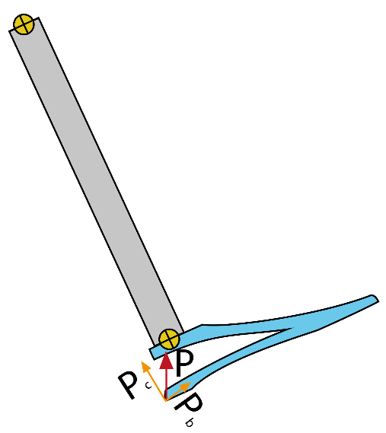
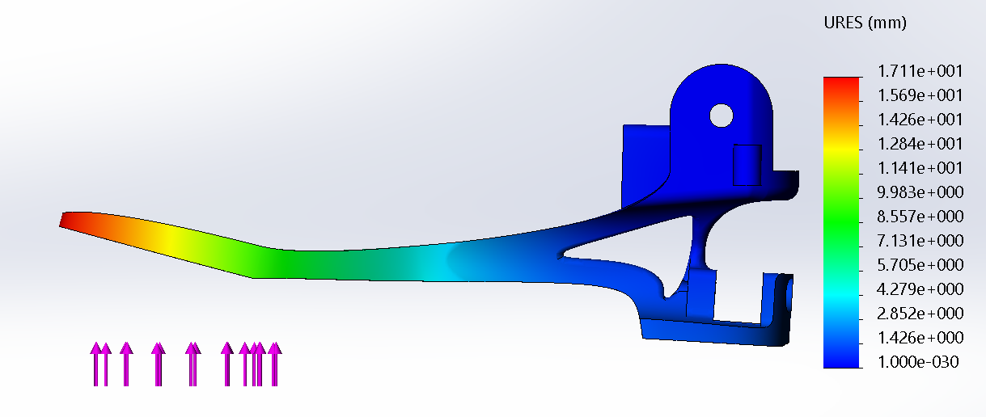
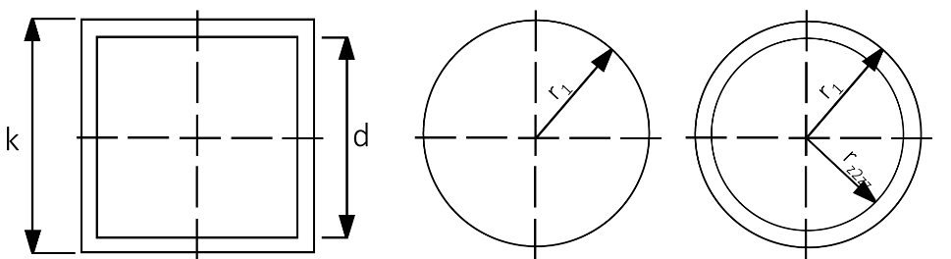
Structural analysis
Introduction
State of the art
Analysis
Mathematical model
Mechatronic design
Simulation
Results
1/30
Notes:
[J]

Slide 22
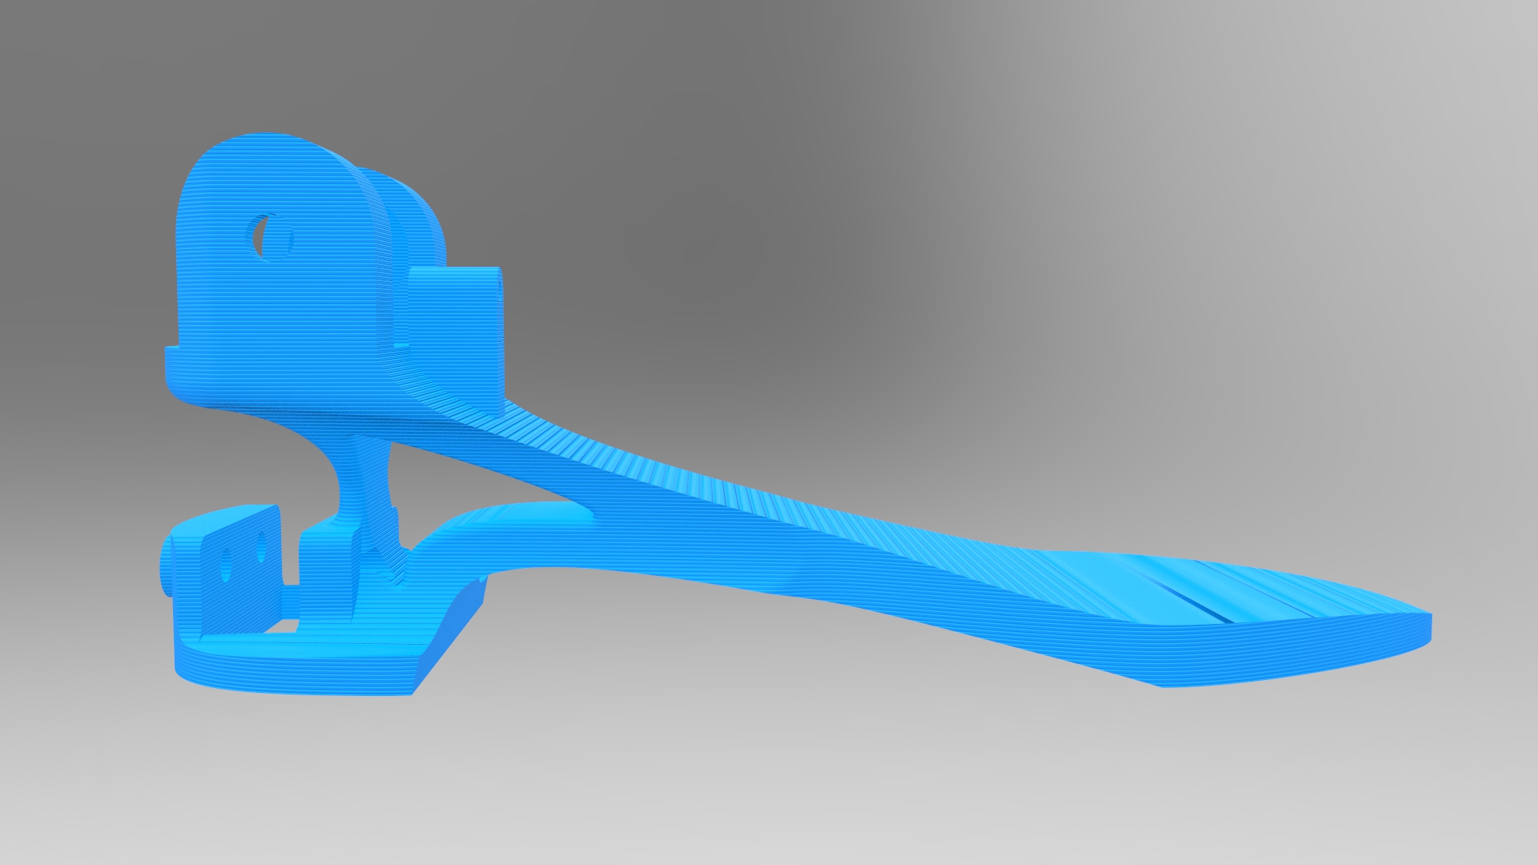
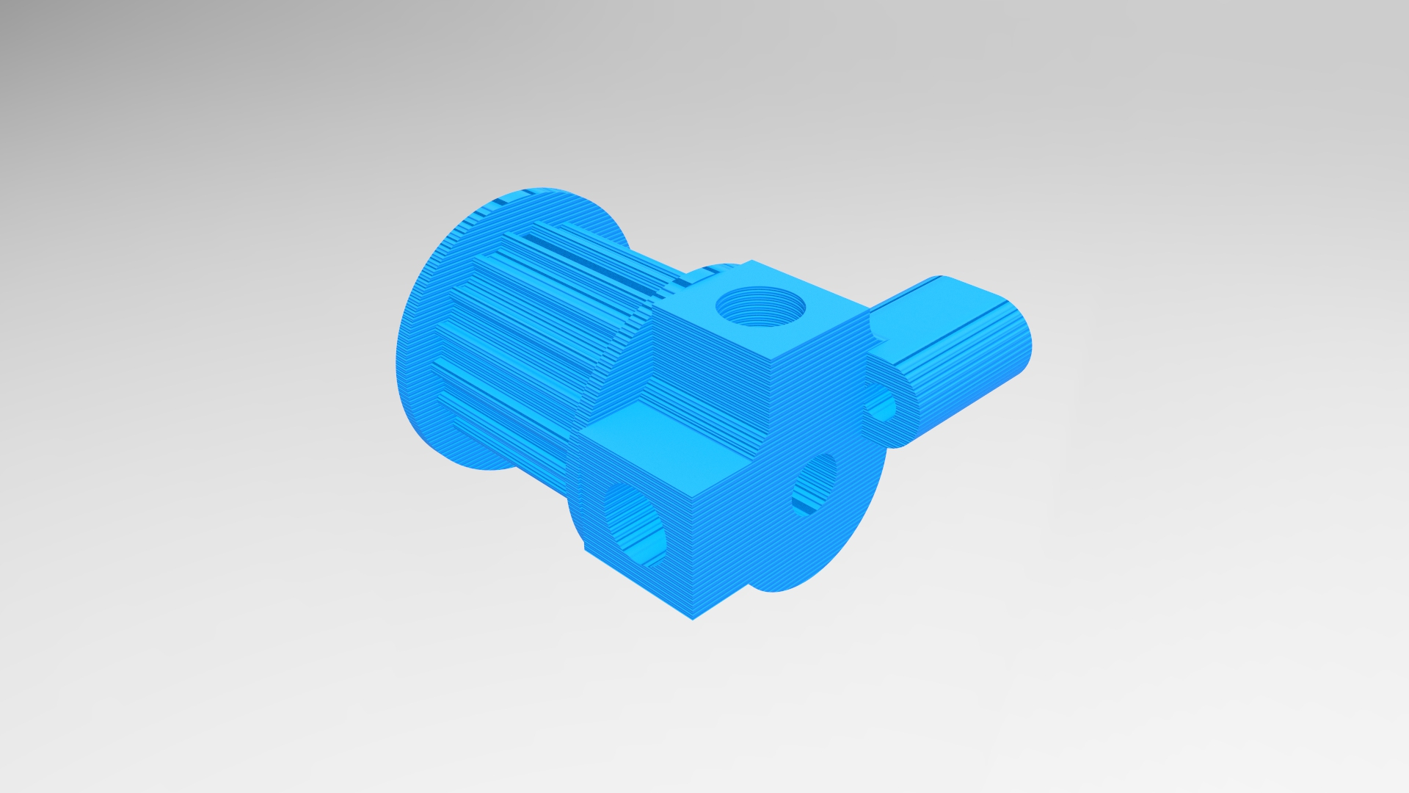
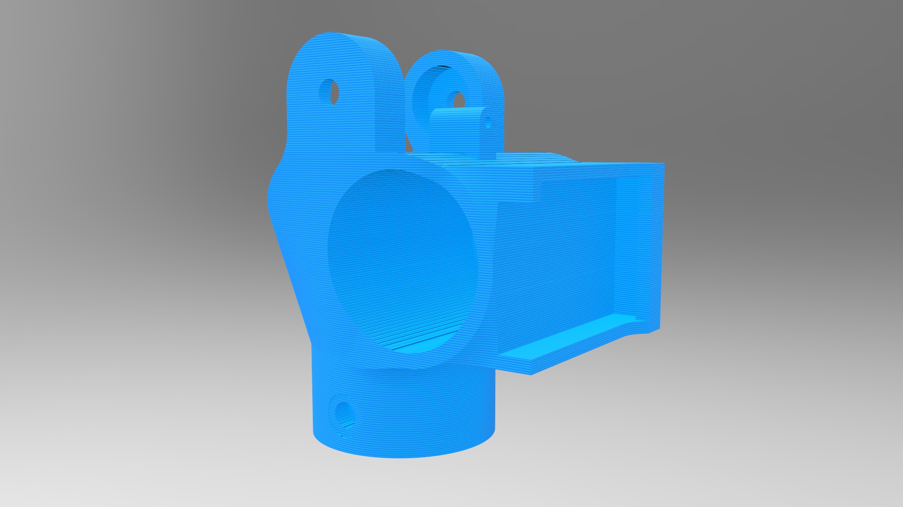
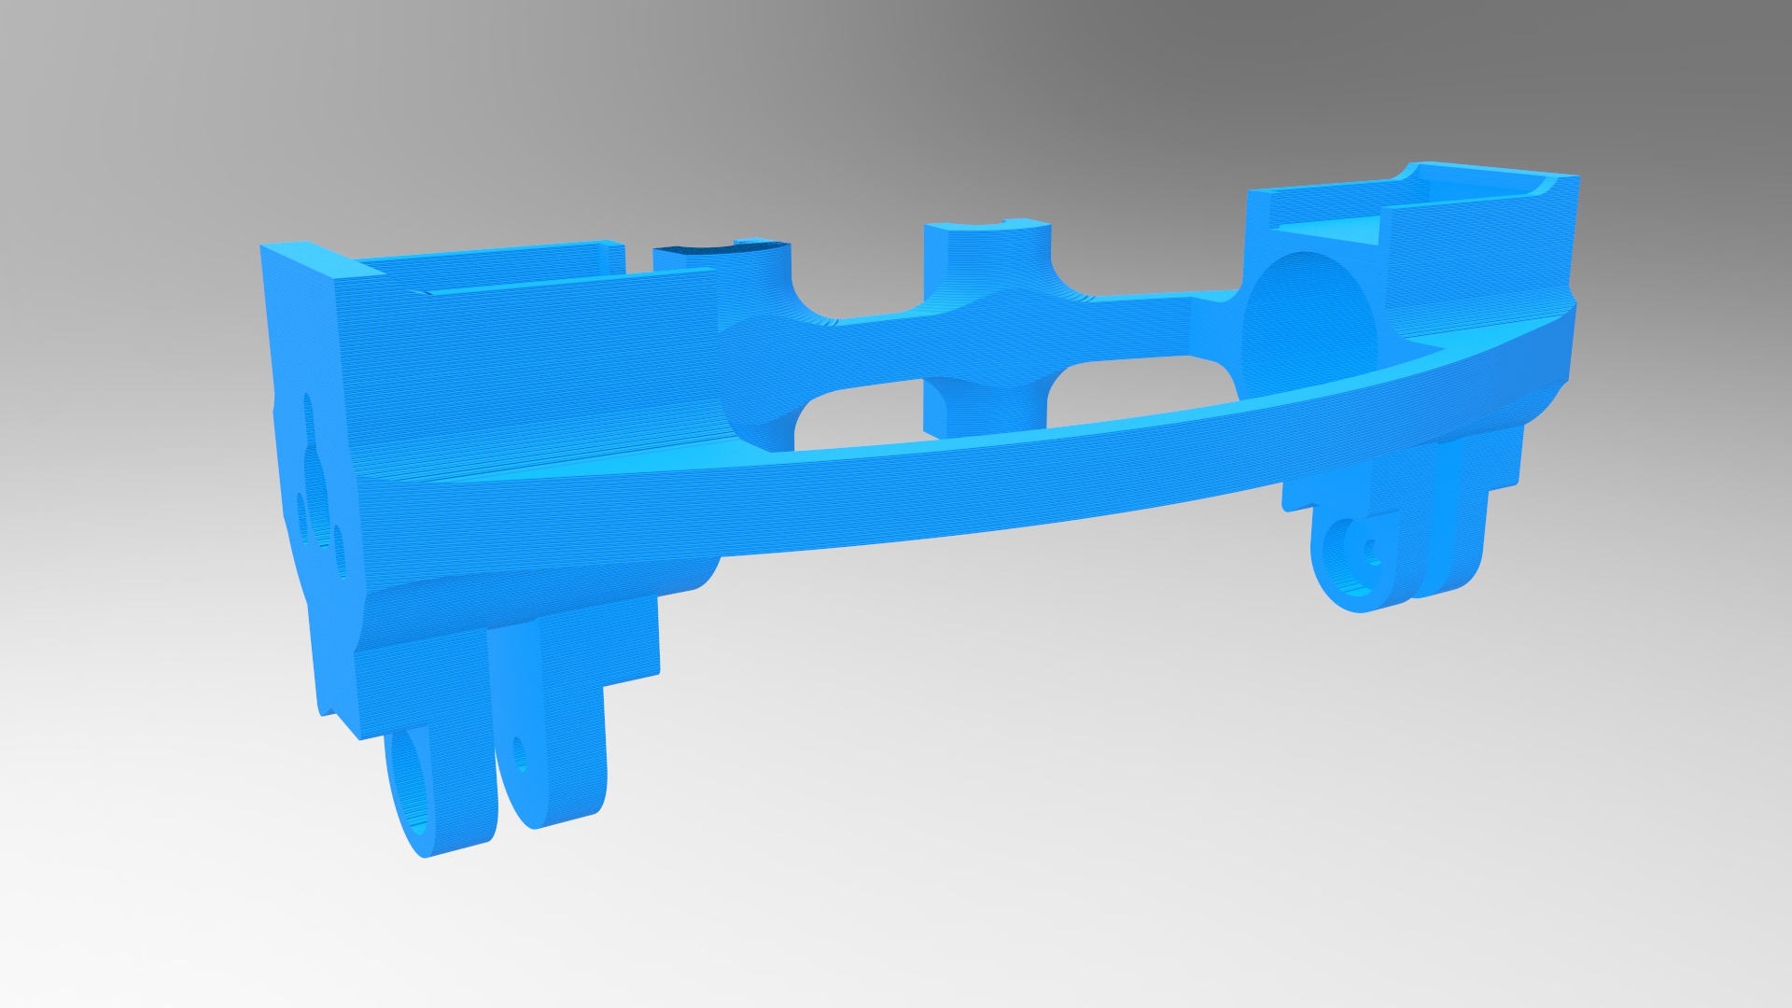
Frame
Introduction
State of the art
Analysis
Mathematical model
Mechatronic design
Simulation
Results
1/30
Notes:
[J]

Slide 23
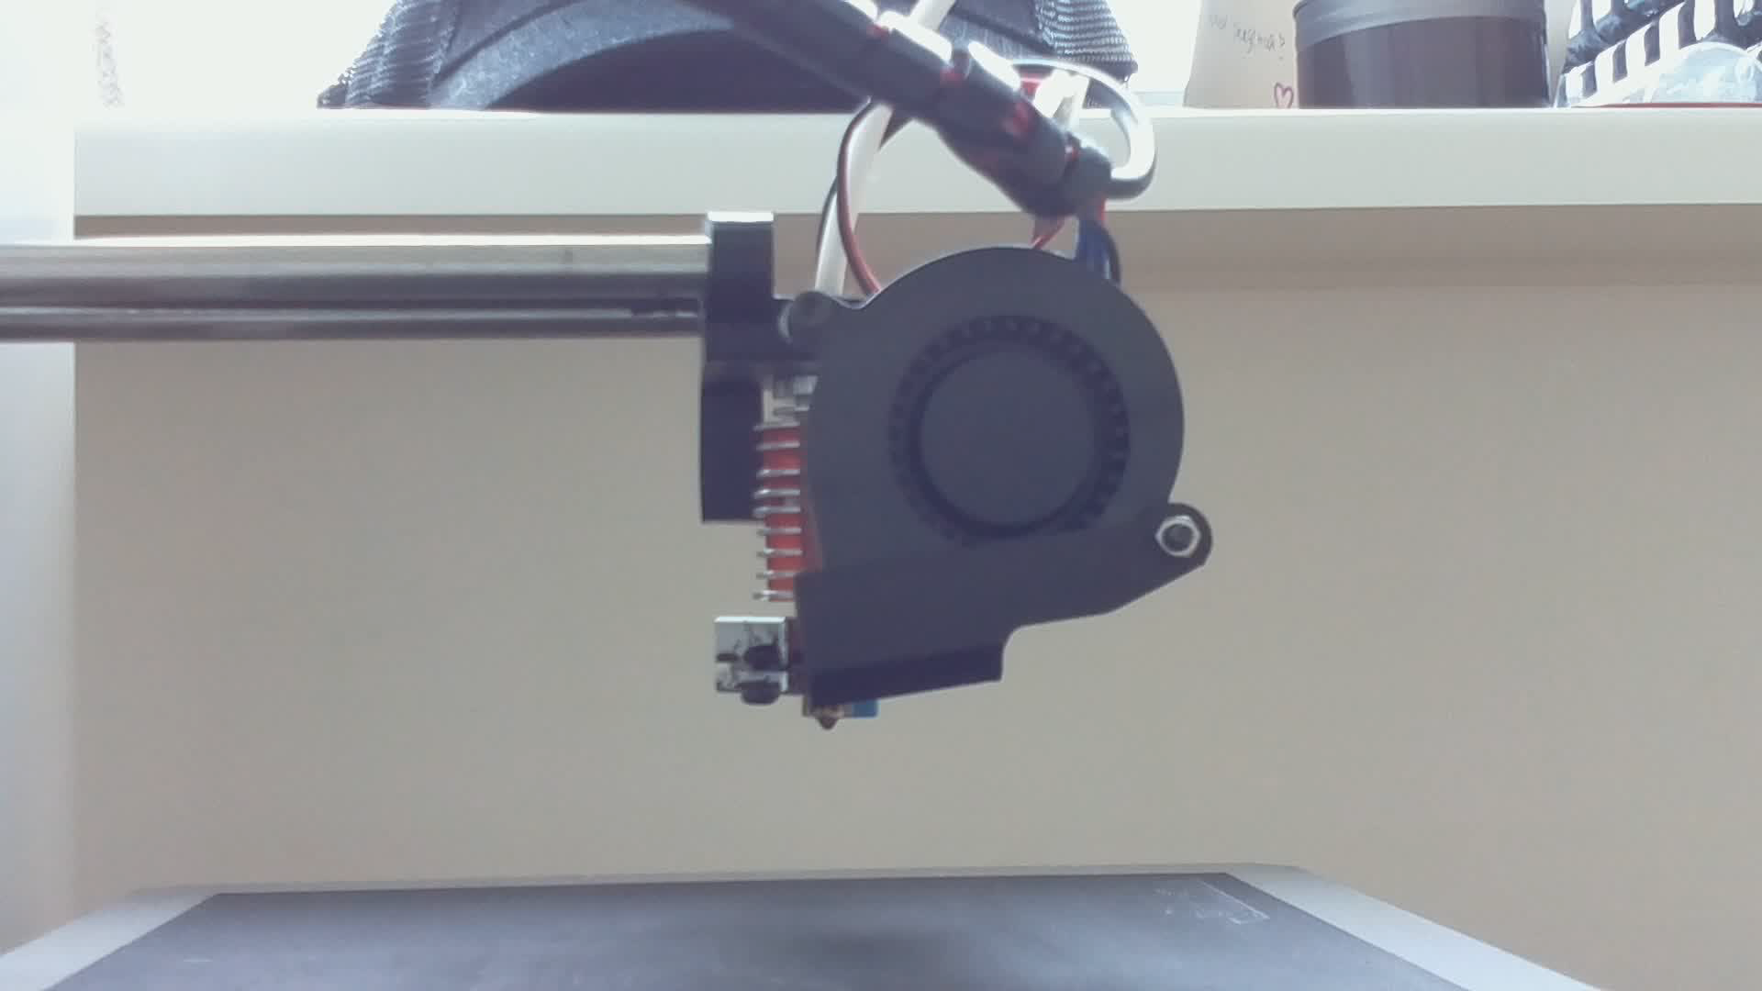
3D printing
Introduction
State of the art
Analysis
Mathematical model
Mechatronic design
Simulation
Results
1/30
Notes:
[J]

Slide 24
Embedded electronics
LocoKit electronics
Extension board
Sensors
Introduction
State of the art
Analysis
Mathematical model
Mechatronic design
Simulation
Results
1/30
Notes:
[N]

Slide 25
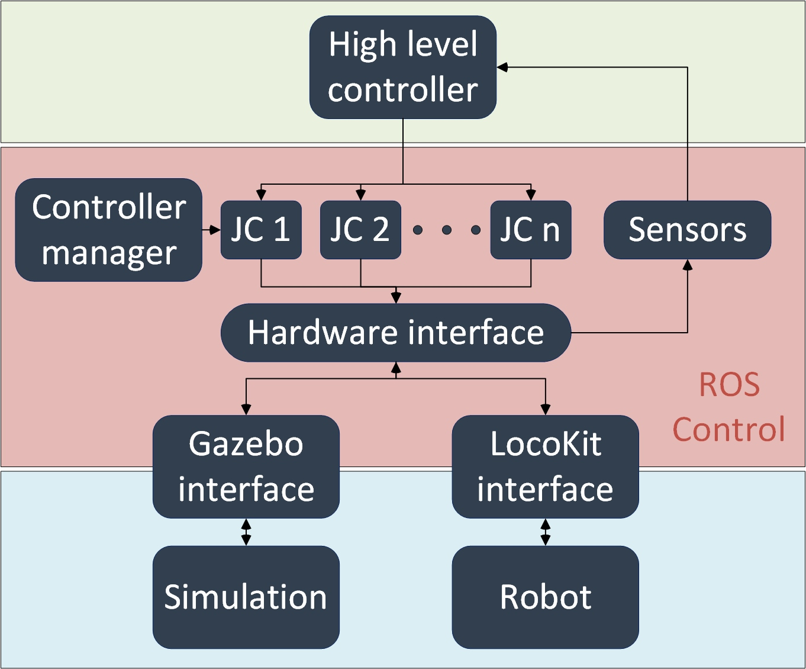
ROS Control
Introduction
State of the art
Analysis
Mathematical model
Mechatronic design
Simulation
Results
1/30
Notes:
[N]

Slide 26
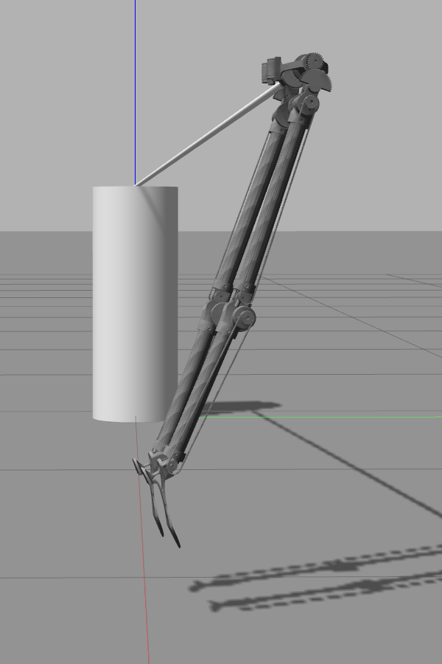
Example controllers
Introduction
State of the art
Analysis
Mathematical model
Mechatronic design
Simulation
Results
Two-neuron controller
Impulse controller
1/30
Notes:
[J]

Slide 27
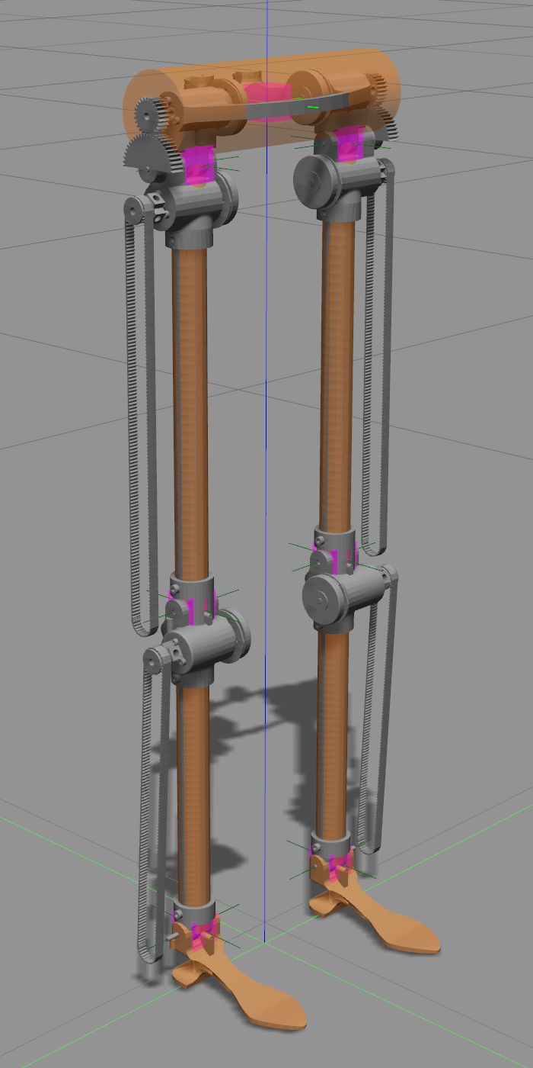
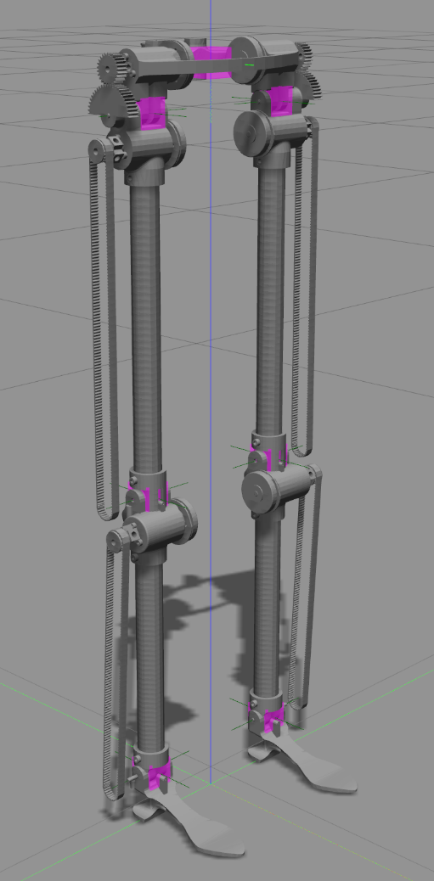
Motivation
Introduction
State of the art
Analysis
Mathematical model
Mechatronic design
Simulation
Results
Gazebo
VS
LPZ robots
1/30
Notes:
[J]

Slide 28
Main characteristics
Introduction
State of the art
Analysis
Mathematical model
Mechatronic design
Simulation
Results
Flags
Scalable
Visual and collision model optimized
Rotational holder
Free movement
Geometry
Masses
Inertias
1/30
Notes:
[J]

Slide 29
Simulation demo!
1/30

Slide 30
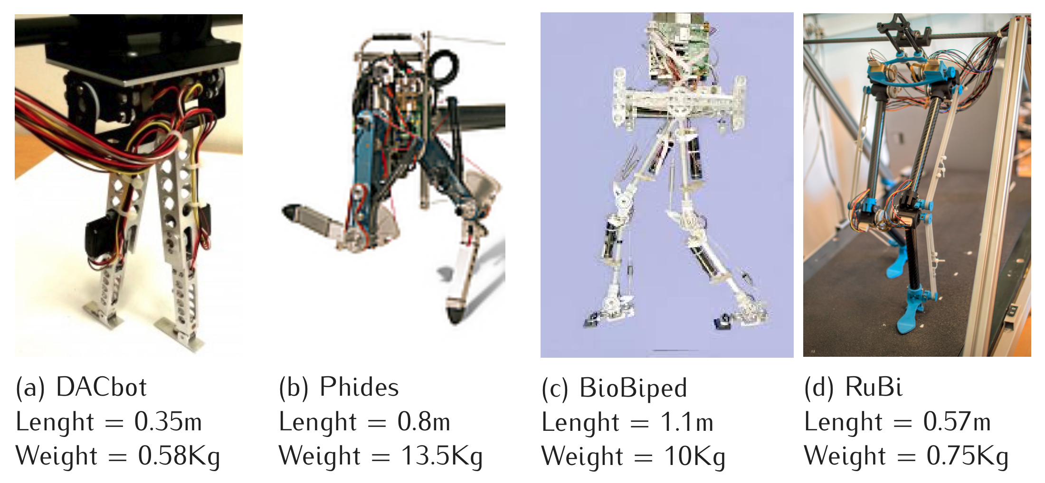
Robot comparative
Introduction
State of the art
Analysis
Mathematical model
Mechatronic design
Simulation
Results
1/30
Notes:
[N]

Slide 31
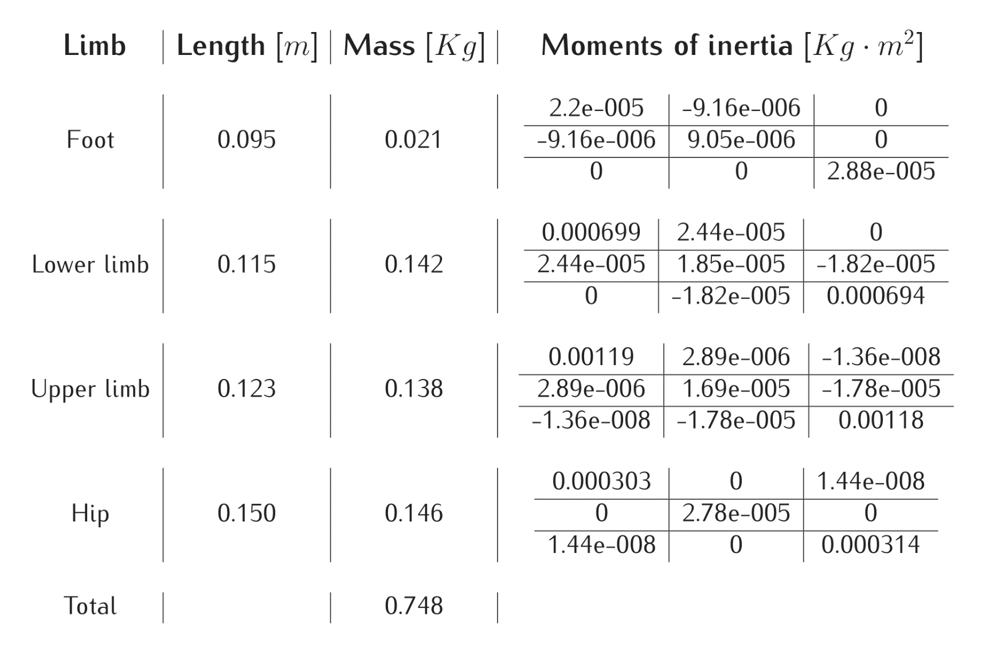
Physical properties
Introduction
State of the art
Analysis
Mathematical model
Mechatronic design
Simulation
Results
1/30
Notes:
[N]

Slide 32
Up!
1/30
Notes:
[N]

Slide 33
Conclusions
Achievements
First RuBi prototype
Missing
Experimentation
Read from I/O
Further work
Extend LocoKit interface in ROS Control
Enhancement of mathematical framework
Controller deployment independence
Reconfigurable morphological computation
Add compliance to simulation
Improvement of belt’s tightening
Reinforcement of some 3D printed parts
Improve assembly process
Introduction
State of the art
Analysis
Mathematical model
Mechatronic design
Simulation
Results
1/30
Notes:
[N] Achievements
[J] Missing and further work

Slide 34
Assembly manual
Assembly manual
Notes:
[J]

